Slide 1
USER
MANUAL
PREMIUM WIDE ASPECT RATIO LED SERIES
<All contents of this document may change without prior notice, and actual product appearance may differ from that depicted herein>

Slide 2
<TABLE OF CONTENTS>
1 | FCC RF INTERFERENCE STATEMENT | 3
2 | INSTALLATION | 4
3 | CONNECTION | 6
4 | PARTS LIST | 7
5 | SPECIFICATION | 8

Slide 3
1. FCC RF INTERFERENCE STATEMENT
NOTE
This equipment has been tested and found to comply with the limits for a Class A digital device, pursuant to Part 15 of the FCC Rules.
These limits are designed to provide reasonable protection against harmful interference in a residential installation. This equipment generates, uses and can radiate radio frequency energy and, if not installed and used in accordance with the instructions, may cause harmful interference to radio communications. However, there is no guarantee that interference will not occur in a particular installation.
If this equipment does cause harmful interference to radio or television reception which can be determined by turning the equipment off and on, the user is encouraged to try to correct the interference by one or more of the following measures.
- Reorient or relocate the receiving antenna.
- Increase the separation between the equipment and receiver.
- Connect the equipment into a circuit different from that to which the receiver is connected.
- Consult the dealer or an experienced radio, monitor technician for help.
- Only shielded interface cable should be used.
Finally, any changes or modifications to the equipment by the user not expressly approved by the grantee or manufacturer could void the users authority to operate such equipment.
DOC COMPLIANCE NOTICE
This digital apparatus does not exceed the Class A limits for radio noise emissions from digital apparatus set out in the radio interference regulation of Canadian Department of communications.

Slide 4
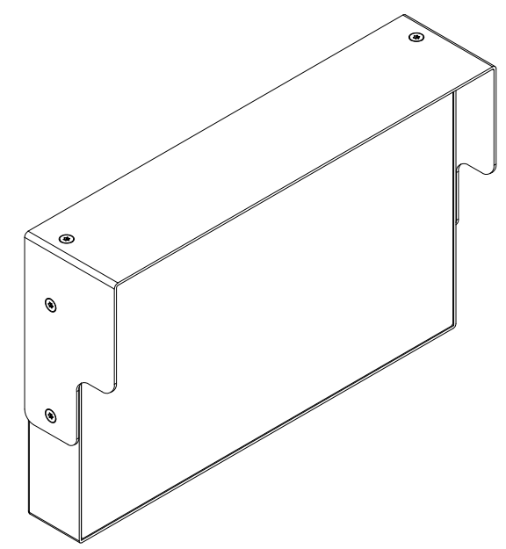

2. INSTALLATION
PARTS
LCD Monitor
User Manual
*Depending on the product model type, there may be variations in appearance.

Slide 5
HOW TO INSTALL
Location of KEY BUTTON
KEY FUNCTION
KEY FUNCTION
OSD Key | Function
Display mode | Display mode switching (CAM1>CAM2>CAM3>CAM4>QUAD) By manual

Slide 6
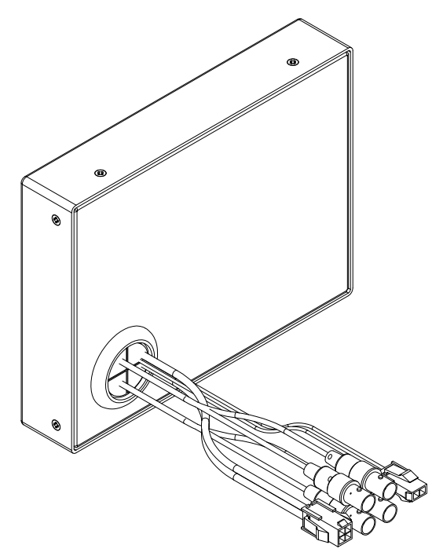

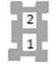
3. CONNECTION
③
②
①
① | Alarm in | Alarm (Black) : High Alarm (Red) : High Alarm (White) : High Alarm (Green) : High Alarm : Low 2 Alarm or more : High (at the same time) | ▶ CH1 Pop up ▶ CH2 Pop up ▶ CH3 Pop up ▶ CH4 Pop up ▶ Quad display ▶ Quad display
② | BNC | CVBS input or Analog HD input
③ | Power | DC 9 – 36V ▶ 1. Red(Power, +) ▶ 2. Black(GND, -)
4.Green
3.White
2.Red
1.Black
2.BLACK
1.RED

Slide 7
4. PARTS LIST
24-0225 | Cable, Power, Mon 8", Molex Minifit Jr, 2pin, 2con, 20AWG, 25FT
24-0325 | Cable, Alarm Triggers, 8“ Monitors , Molex Micro-fit 3.0, 4pin, 4con, 20AWG, w/ #10 Ring Terminals, 25FT
24-0505 | Mount, Monitor, RAM, VESA 75, for 8" Monitors, 5.225" with C Size 1.5" Balls
20-0015 | Cable, Coax Mini, BNC Males, Video, 15FT
20-0020 | Cable, Coax Mini, BNC Males, Video, 20FT
20-0025 | Cable, Coax Mini, BNC Males, Video, 25FT
20-0030 | Cable, Coax Mini, BNC Males, Video, 30FT
20-0005 | Cable, Coax Mini, BNC Males, Video, 5FT
20-0070 | Cable, Coax Mini, BNC Males, Video, 70FT

Slide 8
5. SPECIFICATION
MODEL |  | 24-0108
Display | Screen Size | 8 inches
 | Resolution | 1024*600
 | Pixel Pitch | 0.1725*0.1656 mm
 | Brightness | 450 cd/m²
 | Aspect Ratio | 16:9
 | Viewing Angle (H/V) | 170º / 170º
Interface | Video In (BNC Type) | 4 (CVBS / Analog HD)
 | Alarm In | 4
Features | Trigger Channel Switching | Y
 | Manual Display Switching | CH1>CH2>CH3>CH4>QUAD
 | QUAD DISPLAY | Y
Dimension | Outline Dimension (with Stand) | 212.8 x 136.4 x 29mm (8.38” x 5.38” x 1.14”)
Cabinet | Cabinet Material | Electro-Galvanized Steel
Power | Electrical Ratings | DC 9~36V
Circumstance | Operating Temperature | 0℃~40℃ Celsius (32º~104º Fahrenheit)
 | Storage Temperature | -20℃~60℃ Celsius (-4º~140º Fahrenheit)
Mounts | VESA Mount Size | 75x75 mm

Slide 12


