Slide 1
USER
MANUAL
PREMIUM WIDE ASPECT RATIO LED SERIES
<All contents of this document may change without prior notice, and actual product appearance may differ from that depicted herein>

Slide 2
<TABLE OF CONTENTS>
1 | FCC RF INTERFERENCE STATEMENT | 3
2 | INSTALLATION | 4
3 | CONNECTION | 6
4 | PARTS LIST | 7
5 | SPECIFICATION | 8

Slide 3
1. FCC RF INTERFERENCE STATEMENT
NOTE
This equipment has been tested and found to comply with the limits for a Class A digital device, pursuant to Part 15 of the FCC Rules.
These limits are designed to provide reasonable protection against harmful interference in a residential installation. This equipment generates, uses and can radiate radio frequency energy and, if not installed and used in accordance with the instructions, may cause harmful interference to radio communications. However, there is no guarantee that interference will not occur in a particular installation.
If this equipment does cause harmful interference to radio or television reception which can be determined by turning the equipment off and on, the user is encouraged to try to correct the interference by one or more of the following measures.
- Reorient or relocate the receiving antenna.
- Increase the separation between the equipment and receiver.
- Connect the equipment into a circuit different from that to which the receiver is connected.
- Consult the dealer or an experienced radio, monitor technician for help.
- Only shielded interface cable should be used.
Finally, any changes or modifications to the equipment by the user not expressly approved by the grantee or manufacturer could void the users authority to operate such equipment.
DOC COMPLIANCE NOTICE
This digital apparatus does not exceed the Class A limits for radio noise emissions from digital apparatus set out in the radio interference regulation of Canadian Department of communications.

Slide 4
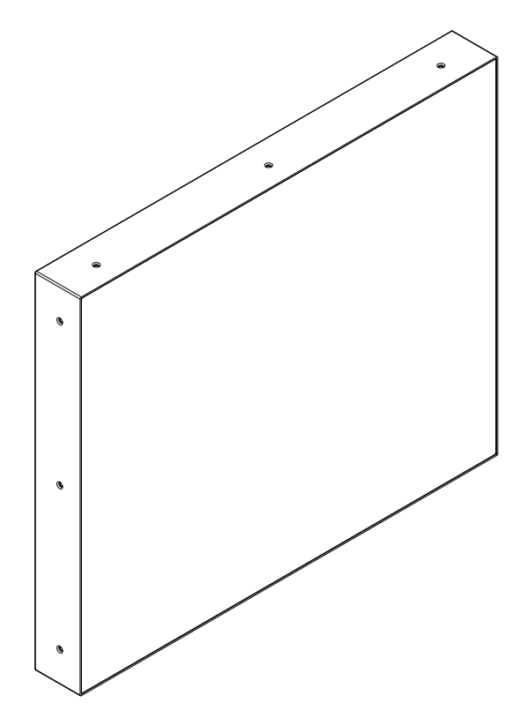

2. INSTALLATION
PARTS
LCD Monitor
User Manual
*Depending on the product model type, there may be variations in appearance.

Slide 5
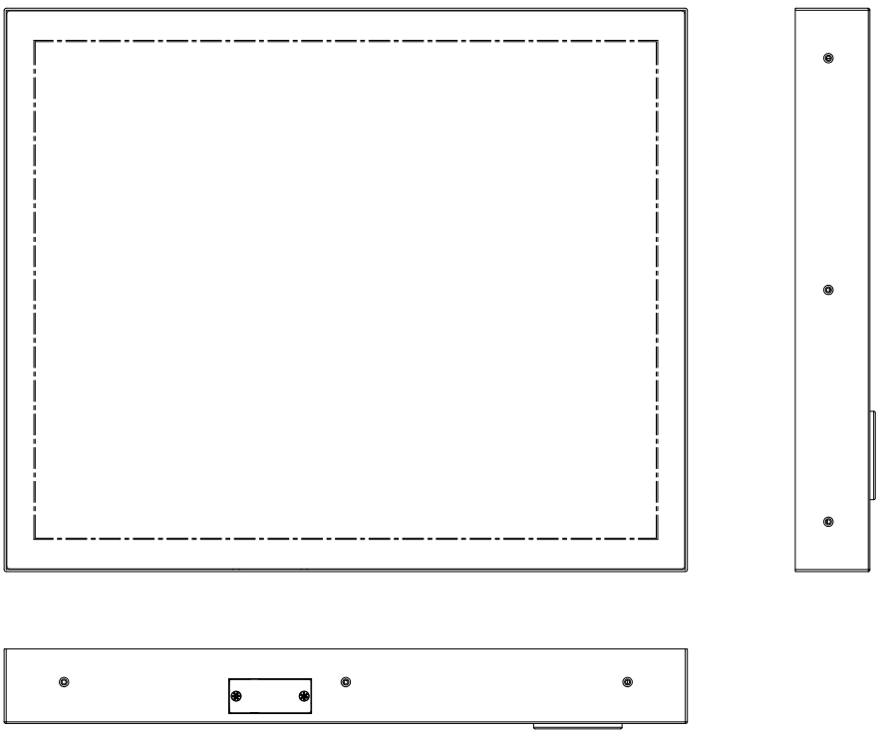
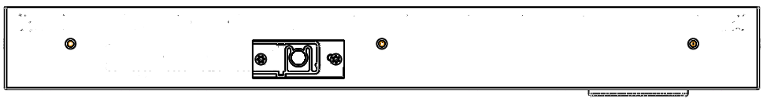
HOW TO INSTALL
Location of KEY BUTTON
KEY FUNCTION
KEY FUNCTION
Key | Function
Trigger Enable/Disable | Press the button to toggle Trigger Enable and Disable Trigger Enable : Tigger signal High -> Camera mode (CVBS) Trigger signal Low -> HDMI mode Trigger Disable : HDMI mode

Slide 6
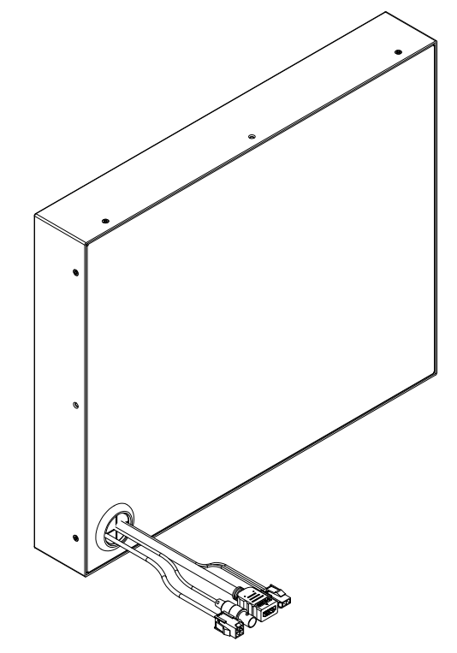
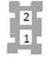
3. CONNECTION
④
③
②
①
① | Alarm in | Alarm (Black) : High - CVBS input is displayed (When Trigger is enable) Low - HDMI input is displayed
② | BNC | CVBS input
③ | HDMI | HDMI input
④ | Power | DC 9 – 36V ▶ 1. Red(Power, +) ▶ 2. Black(GND, -)
2. NC
1. BLACK
2.BLACK
1.RED

Slide 7
4. PARTS LIST
24-0210 | Cable, Power, Mon 19", Molex Minifit Jr, 2pin, 2con, 20AWG, 10FT
24-0410 | Cable, HDMI, 8K, 2.1V Certified, 48G, HDR, HDCP2.3, 4K/120Hz, 10FT

Slide 8
5. SPECIFICATION
MODEL |  | 24-0019
Display | Screen Size | 19 inches
 | Resolution | 1280*1024
 | Pixel Pitch | 0.294*0.294 mm
 | Brightness | 250 cd/m²
 | Aspect Ratio | 5:4
 | Viewing Angle (H/V) | 178º / 178º
Interface | HDMI In | 1
 | Video In (BNC Type) | 1 (CVBS)
 | Alarm In | 1
Features | Trigger Video source Switching | Y
Dimension | Outline Dimension (with Stand) | 424.2 x 349.2 x 45mm (16.7” x 13.75” x 1.77”)
Cabinet | Cabinet Material | Electro-Galvanized Steel
Power | Electrical Ratings | DC 9~36V
Circumstance | Operating Temperature | 0~40 Celsius (32º~104º Fahrenheit)
 | Storage Temperature | -20~60 Celsius (-4º~140º Fahrenheit)
Mounts | VESA Mount Size | 100x100 mm

Slide 12


